Slide 1
Predicting Client Subscriptions to Term Deposits
AI Singapore’s AI Apprenticeship Programme (AIAP) - Batch 20
Muhammad Faizal Bin Ehsan

Slide 2
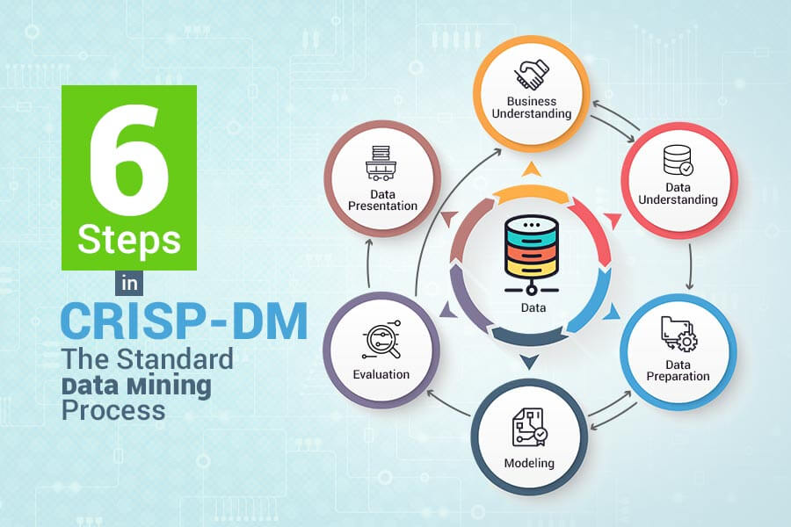
Problem Statement
The bank needs to predict which clients are likely to subscribe to a term deposit.
While client and campaign data exist, they aren’t fully utilized to guide marketing actions.
Smarter predictions can boost engagement, reduce wasted effort, and improve resource allocation.

Slide 3
Business Objectives
Accurately identify clients most likely to subscribe to increase campaign success.
Focus efforts and budget on high-potential leads to reduce waste and maximize ROI.
Use data-driven insights to personalize outreach and improve client relationships.

Slide 4
Business Success Criteria
A measurable increase in term deposit sign-ups from targeted marketing efforts.
Reduced cost per acquisition through better targeting and smarter resource use.
Clear understanding of key client attributes that drive successful subscriptions.

Slide 5
Solution Statement
Create an AI system to predict client subscription likelihood
Create an ML model to classify clients by their likelihood of subscribing
Integrate the ML model into the existing application to streamline targeting and campaign optimization

Slide 6
Data Sources
Internal data sources:
Client demographics (age, occupation, marital status)
Contact methods and campaign interactions
Provided by IT and Marketing teams
Source of Dataset: https://techassessment.blob.core.windows.net/aiap20-assessment-data/bmarket.db
External data sources:
None

Slide 7
Data Variables
Variable | Type | Description | Sample Values / Examples
Client ID | Identifier | Unique identifier for the client. | 32885, 3170, 32207
Age | Numerical | The age of the client. | '57 years', '33 years', '150 years'
Occupation | Categorical | Type of job held by the client. | 'technician', 'admin.', 'retired', 'unknown'
Marital Status | Categorical | Marital status of the client. | 'married', 'single', 'divorced', 'unknown'
Education Level | Categorical | Highest education level attained by the client. | 'high.school', 'basic.9y', 'illiterate', 'unknown'
Credit Default | Categorical (nominal) | Indicates if the client has a credit in default. | 'yes', 'no', 'unknown'
Housing Loan | Categorical (nominal) | Indicates if the client has a housing loan. | 'yes', 'no', None, 'unknown'
Personal Loan | Categorical (nominal) | Indicates if the client has a personal loan. | 'yes', 'no', None, 'unknown'
Contact Method | Categorical | Method of contact during the campaign | 'cellular', 'Cell', 'telephone', 'Telephone'
Campaign Calls | Numerical | Number of contact attempts during campaign | 1, 3, 5, -11, 42, -35
Previous Contact Days | Numerical | Days since last contact (999 = never) | 3, 10, 26, 999
Subscription Status | Binary | Whether the client subscribed to a term deposit. | 'yes', 'no'

Slide 8
Data Collection Plan
Gather client and campaign data from IT and Marketing teams.
Handle missing values, outliers, and inconsistent categories.
Continuously check for consistency and accuracy in incoming data.

Slide 9
Data Preparation Plan
Data preprocessing:
Remove irrelevant columns
Dropped Client ID (not necessary for analysis).
Clean and process Age
Removed ' years' text, converted to numeric, and removed outliers (e.g., Age > 149).
Reclassify Occupation and Education Level
Mapped Occupation to categories like blue_collar and white_collar.
Simplified Education Level to categories like secondary and university.
Handle missing values
Replaced missing values in Marital Status, Housing Loan, and Personal Loan with 'unknown'.
Standardize Contact Method
Replaced inconsistent values like 'Cell' to 'cellular' and 'Telephone' to 'telephone'.

Slide 10
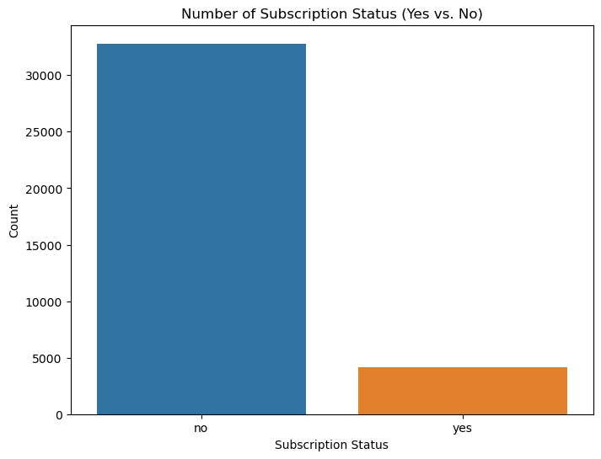
Data Preparation Plan
Exploratory data analysis:
Majority decline term deposits: Only ~10% subscribe ('yes') vs. 90% ('no'). (Highly imbalanced data, need stratified sampling or class weights.)

Slide 11
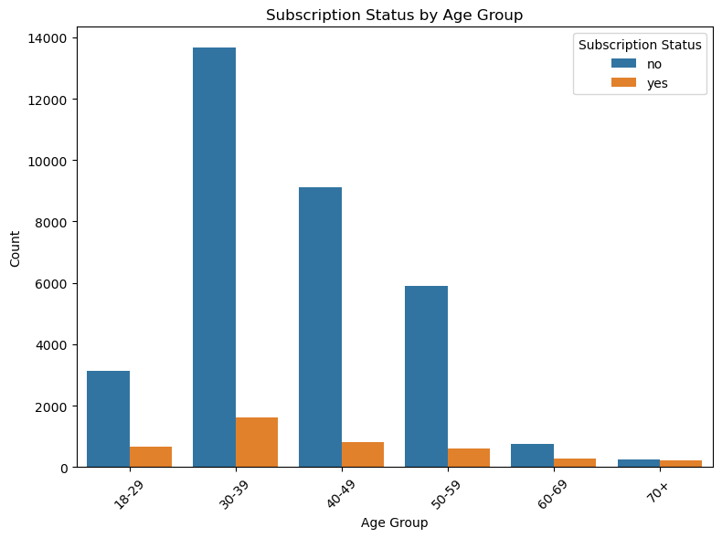
Data Preparation Plan (cont.)
Exploratory data analysis:
Clients aged 30-49 are most likely to subscribe; seniors (70+) rarely do. (Peak earning years may drive investment interest.)

Slide 12
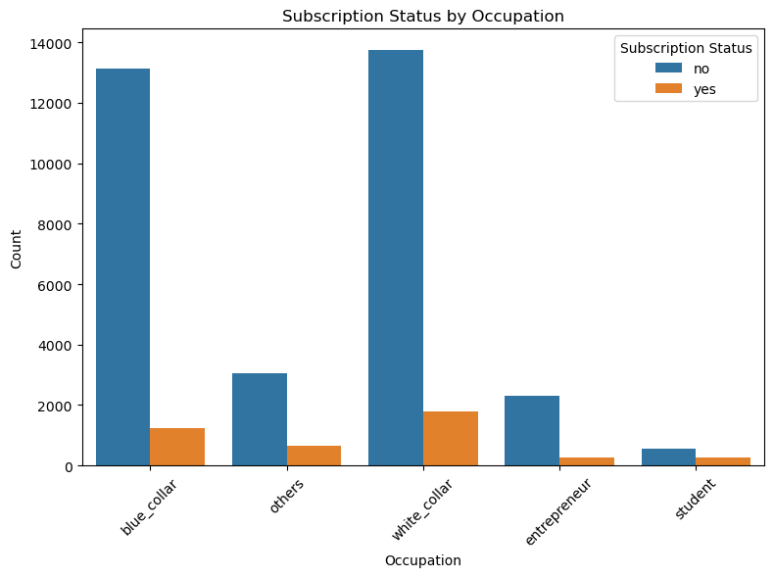
Data Preparation Plan (cont.)
Exploratory data analysis:
Blue/white-collar workers show higher subscription rates than students and entrepreneurs (Likely due to liquidity needs vs. long-term planning.)

Slide 13
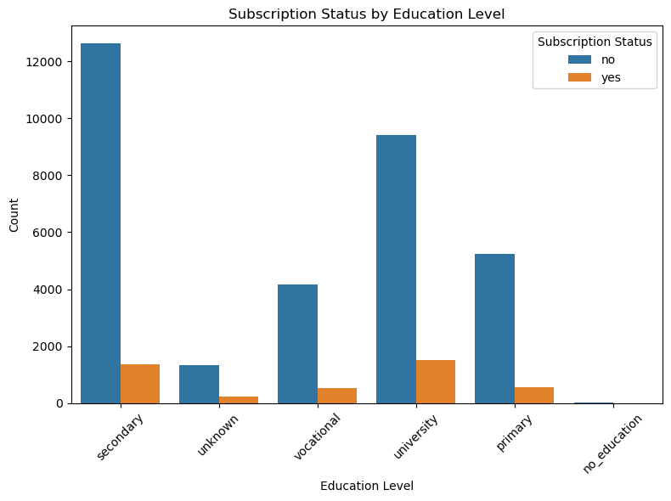
Data Preparation Plan (cont.)
Exploratory data analysis:
University-educated clients subscribe most; no-education group rarely does. (Financial literacy likely plays a role.)

Slide 14
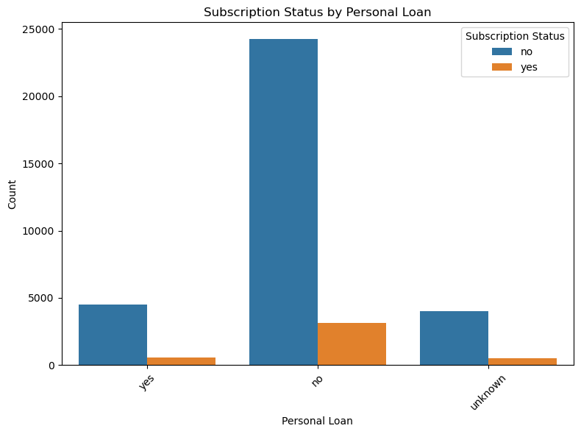
Data Preparation Plan (cont.)
Exploratory data analysis:
Without personal loans show higher subscription rates than with personal loans.
(Debt burden reduces disposable income for savings.)

Slide 15
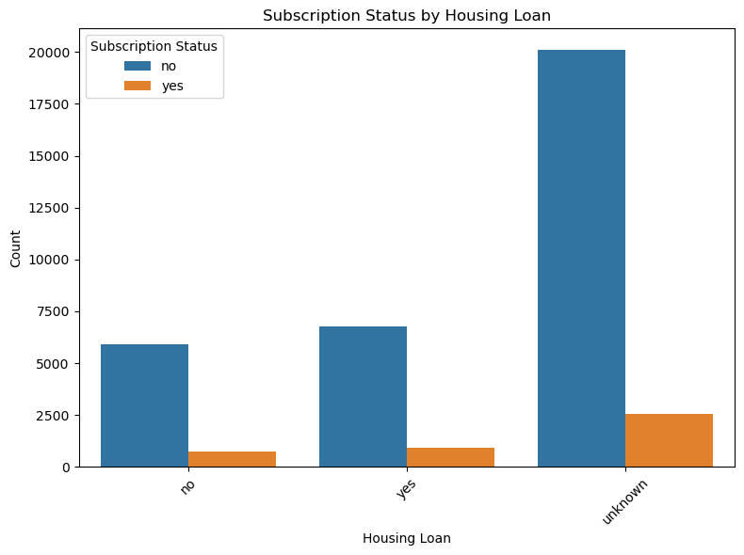
Data Preparation Plan (cont.)
Exploratory data analysis:
No significant difference in subscription rates except for “unknown”.

Slide 16
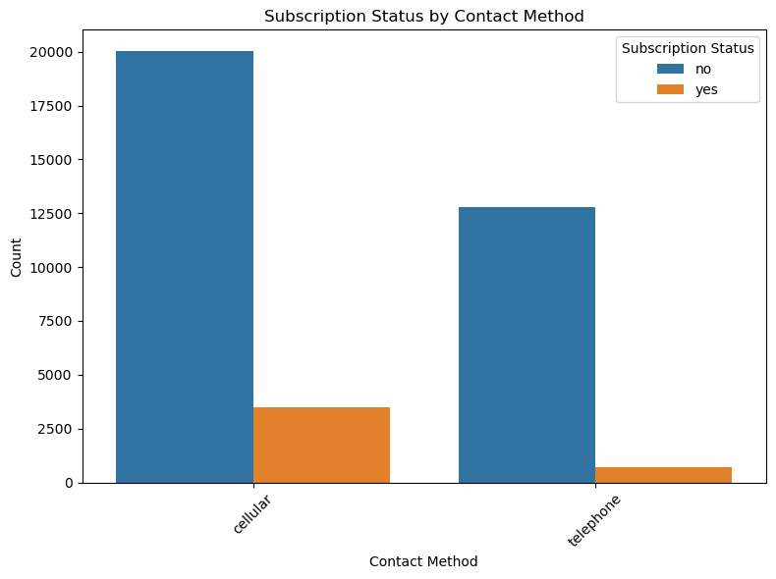
Data Preparation Plan (cont.)
Exploratory data analysis:
Cellular contacts yield 2× more subscriptions than telephone calls. (Mobile outreach may be more effective/accessible.)

Slide 17
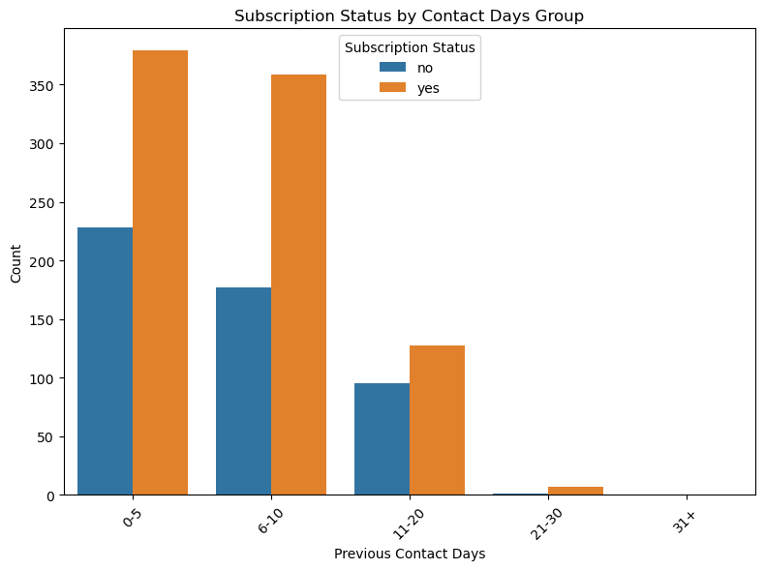
Data Preparation Plan (cont.)
Exploratory data analysis:
80% of conversions occur within 10 days of contact.
Leads beyond 20 days rarely convert (<2% success)

Slide 18
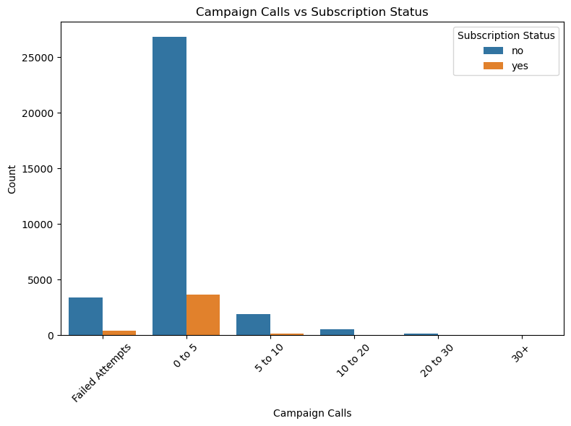
Data Preparation Plan (cont.)
Exploratory data analysis:
1-5 contact attempts work best; >10 attempts drive 90% rejections. (Over-contacting harms conversion—optimize call frequency.)

Slide 19
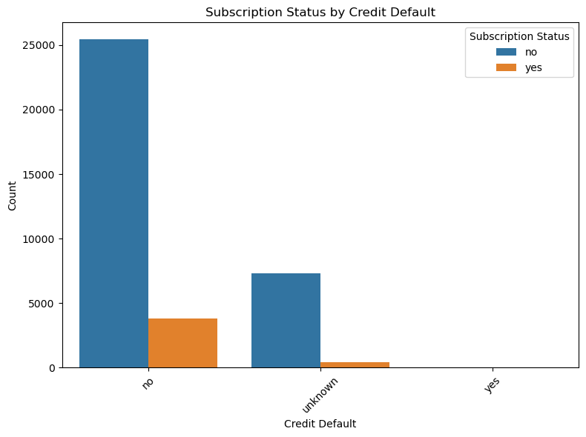
Data Preparation Plan (cont.)
Exploratory data analysis:
Non-defaulters are 5× more likely to subscribe than defaulters. (Creditworthiness strongly predicts financial engagement.)

Slide 20
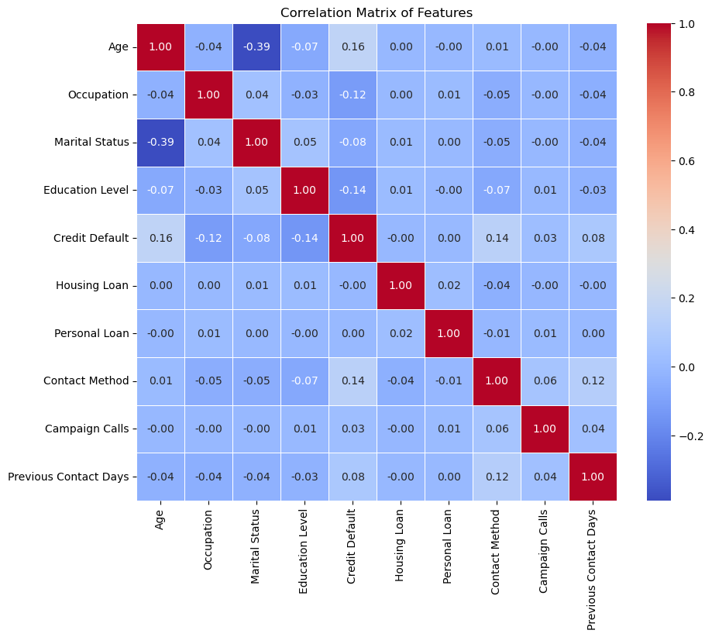
Data Preparation Plan (cont.)
Exploratory data analysis:
Low Multicollinearity: No feature pairs exceed |0.5| correlation, reducing redundancy risks, avoiding feature overlapping so much that it becomes not useful.

Slide 21
Modeling Plan
Data mining task:
Prediction (Classification): Predict if a client will subscribe to a term deposit.
Independent Variables: Age, Occupation, Marital Status, Education Level, Credit Default, Housing Loan, Personal Loan, Contact Method, Campaign Calls, Previous Contact Days.
Dependent Variable: Subscription Status.
Type of learning:
Supervised Learning: Using labeled data to predict the target variable (Subscription Status).

Slide 22
Modeling Plan (cont.)
Algorithms:
Logistic Regression
Baseline model for binary classification; simple and interpretable.
Random Forest
Ensemble of decision trees; handles non-linear relationships well.
Decision Tree
Rule-based model; easy to visualize and interpret.
Naive Bayes
Probabilistic model; fast and works well with categorical data.
XGBoost
High-performance boosting algorithm; effective for structured data.

Slide 23
Assessing Usefulness of Models
Assessing model assumptions:
Logistic Regression:
Assumes low multicollinearity.
Naive Bayes:
Assumes feature independence.
Tree-Based Models (Decision Tree/Random Forest/XGBoost):
Prone to overfitting on small/noisy datasets.

Slide 24
Assessing Usefulness of Models (cont.)
Assessing model performance:
Logistic Regression is the best model with the highest accuracy (89.55%) and a ROC AUC of 0.72, but has low recall for the Yes class.
XGBoost (accuracy: 89.31%, ROC AUC: 0.73) offers a slight improvement in AUC but still struggles with Yes class recall.
Random Forest and Decision Tree perform worse, with ROC AUC scores of 0.67 and 0.60, respectively, and also show bias toward the majority class.
Naive Bayes (accuracy: 89.43%, ROC AUC: 0.73) shows similar performance to XGBoost, with a slightly better accuracy and a comparable ROC AUC, but still faces challenges with the minority class recall.
While XGBoost and Naive Bayes offer good performance, class balancing and data augmentation are crucial for improving recall for the Yes class.

Slide 25
Evaluation Plan
Assessing business success criteria:
1. Increase Term Deposit Sign-ups
Filters out unlikely clients (90% "No" accuracy).
Misses 75-80% of potential subscribers (low "Yes" recall).
2. Reduce Cost Per Acquisition
Targets high-likelihood groups (e.g., educated 30-49yo).
Poor recall forces broader outreach → higher costs.
3. Identify Key Client Attributes
Clear drivers found (education, age, no loans).
Needs real-world validation.

Slide 26
Evaluation Plan (cont.)
Generality of the model:
Works Best On:
Clients with clear patterns (university-educated, 30-49yo, no loans).
Cellular contacts within 5 days of outreach.
Struggles With:
Rare edge cases (e.g., subscribers with personal loans or retirees).
Non-linear relationships (e.g., interactions between age and occupation).
Limited Scope:
Predictions assume historical patterns hold (may fail with new customer segments).
Requires frequent retraining if market trends shift (e.g., new loan products).

